Slide 1
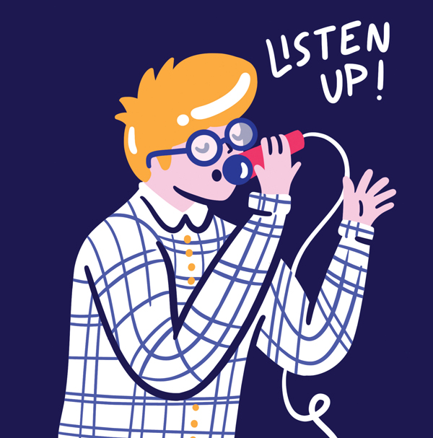




Slam Poetry
Year 9
Notes:
Copyright © 2019 Jeanne Wolz, www.teacheroffduty.com. For classroom use only by a single teacher. Please purchase one licensure per teacher using this product. All rights reserved.

Slide 2
Note to the teacher:
ALL online resources for this unit can be found here:
Http://teacheroffduty.com/identity-assumptions-slam-poetry-unit-plan-materials/
Notes:
Copyright © 2019 Jeanne Wolz, www.teacheroffduty.com. For classroom use only by a single teacher. Please purchase one licensure per teacher using this product. All rights reserved.

Slide 3
Slam Poetry: Day 1
Notes:
Copyright © 2019 Jeanne Wolz, www.teacheroffduty.com. For classroom use only by a single teacher. Please purchase one licensure per teacher using this product. All rights reserved.

Slide 4

Do Now
Write in planner: Optional: watch slam poems on YouTube on your own | 2. Get out: If you see this→ it means get out a pen/pencil, which is what you should do now☺
Learning Intentions
What: Define slam poetry. How: Watching several slam poems, and talking and writing about what we think it is. Why: Because it’s an amazing form of poetry, and you’re going to have the opportunity to write a slam poem soon!
Notes:
Copyright © 2019 Jeanne Wolz, www.teacheroffduty.com. For classroom use only by a single teacher. Please purchase one licensure per teacher using this product. All rights reserved.

Slide 5

Quick-write
What is Poetry? And what is not Poetry?
Notes:
Copyright © 2019 Jeanne Wolz, www.teacheroffduty.com. For classroom use only by a single teacher. Please purchase one licensure per teacher using this product. All rights reserved.

Slide 6
Poetry
NOUN
poetry (noun) · poetries (plural noun)
literary work in which the expression of feelings and ideas is given intensity by the use of distinctive style and rhythm; poems collectively or as a genre of literature.

Slide 7


Slide 8
Slam Poetry
Notes:
Copyright © 2019 Jeanne Wolz, www.teacheroffduty.com. For classroom use only by a single teacher. Please purchase one licensure per teacher using this product. All rights reserved.

Slide 9
As the poet is performing, write what you think…
What is slam poetry?
Slam poetry is….
It is different than other poetry because….
It sounds like…
It reminds me of….
Notes:
Copyright © 2019 Jeanne Wolz, www.teacheroffduty.com. For classroom use only by a single teacher. Please purchase one licensure per teacher using this product. All rights reserved.

Slide 10
Talk with your partner
What did you think of the poem?
I liked that…because….
It surprised me when…
I liked the part where…
I agreed when they said…
What do you think slam poetry is?
Slam poetry is….
I think this because…
It is different than other poetry because….
Notes:
Copyright © 2019 Jeanne Wolz, www.teacheroffduty.com. For classroom use only by a single teacher. Please purchase one licensure per teacher using this product. All rights reserved.

Slide 11
Write in your notes..
What did you think of the poem?
I liked that…because….
It surprised me when…
I liked the part where…
I agreed when they said…
What do you think slam poetry is?
Slam poetry is….
I think this because…
It is different than other poetry because….
Notes:
Copyright © 2019 Jeanne Wolz, www.teacheroffduty.com. For classroom use only by a single teacher. Please purchase one licensure per teacher using this product. All rights reserved.

Slide 12
As the poets are performing, think…
How is this slam poem similar or different to the last?
This poem is different in that…
This poem is similar in that…
So I think slam poetry can be…
Notes:
Copyright © 2019 Jeanne Wolz, www.teacheroffduty.com. For classroom use only by a single teacher. Please purchase one licensure per teacher using this product. All rights reserved.

Slide 13
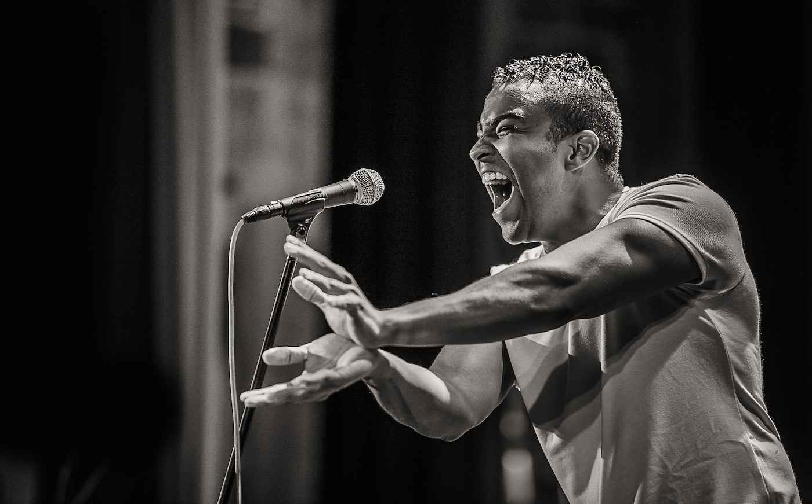
Slam poetry
Slam poetry is a form of performance poetry that combines the elements of performance, writing, competition, and audience participation.
It is performed at events called poetry slams.

Slide 14
Success criteria
I can define poetry.
I can list 2 forms of poetry.
I can describe slam poetry and what makes it unique

Slide 15
Day 2
Notes:
Copyright © 2019 Jeanne Wolz, www.teacheroffduty.com. For classroom use only by a single teacher. Please purchase one licensure per teacher using this product. All rights reserved.

Slide 16
Do Now
Write in planner: Finish “My Multi-dimensional Identity” journal | 2. Get out:
Learning Intentions
What: Identifying different parts that make up our identity. How: By writing about them. Why: Because these will help us identify what our own, unique message is.
Notes:
Copyright © 2019 Jeanne Wolz, www.teacheroffduty.com. For classroom use only by a single teacher. Please purchase one licensure per teacher using this product. All rights reserved.

Slide 17
Slam Poetry Unit Overview
Over the next few weeks, we will…
What:
Develop deeper understanding of our own identities
Challenge assumptions other people might make about those identities
How:
Watching slam poems for ideas
Writing 2+ slam poems challenging assumptions
Why:
Only one person can tell your message, and that person is YOU.
Notes:
Copyright © 2019 Jeanne Wolz, www.teacheroffduty.com. For classroom use only by a single teacher. Please purchase one licensure per teacher using this product. All rights reserved.

Slide 18
Quick-write
What forms your identity?
What are some things someone might identify with?
Notes:
Copyright © 2019 Jeanne Wolz, www.teacheroffduty.com. For classroom use only by a single teacher. Please purchase one licensure per teacher using this product. All rights reserved.

Slide 19
Work-Time Today:
List elements of your identity
Choose one and free-write about it
Notes:
Copyright © 2019 Jeanne Wolz, www.teacheroffduty.com. For classroom use only by a single teacher. Please purchase one licensure per teacher using this product. All rights reserved.

Slide 20
Share-Time Today:
Underline your favorite sentence you wrote today
Notes:
Copyright © 2019 Jeanne Wolz, www.teacheroffduty.com. For classroom use only by a single teacher. Please purchase one licensure per teacher using this product. All rights reserved.

Slide 21
Day 3
Notes:
Copyright © 2019 Jeanne Wolz, www.teacheroffduty.com. For classroom use only by a single teacher. Please purchase one licensure per teacher using this product. All rights reserved.

Slide 22
Do Now
Write in planner: Finish journaling about Assumptions | 2. Get out:
Learning Intentions
What: Identify assumptions that we’ve witnessed and write about them. How: Talk and write about assumptions in slam poems and in our own lives. Why: Identifying assumptions that you can challenge is a critical step in telling a message that the world needs to hear.
Notes:
Copyright © 2019 Jeanne Wolz, www.teacheroffduty.com. For classroom use only by a single teacher. Please purchase one licensure per teacher using this product. All rights reserved.

Slide 23
Quick-write
What is an assumption?
Notes:
Copyright © 2019 Jeanne Wolz, www.teacheroffduty.com. For classroom use only by a single teacher. Please purchase one licensure per teacher using this product. All rights reserved.

Slide 24
“Times I’ve Been Mistaken For A Girl”
Notes:
Copyright © 2019 Jeanne Wolz, www.teacheroffduty.com. For classroom use only by a single teacher. Please purchase one licensure per teacher using this product. All rights reserved.

Slide 25
Talk with your partner
What did you think of the poem?
I liked that…because….
It surprised me when…
I liked the part where…
I agreed when they said…
I wondered what he meant by…
Notes:
Copyright © 2019 Jeanne Wolz, www.teacheroffduty.com. For classroom use only by a single teacher. Please purchase one licensure per teacher using this product. All rights reserved.

Slide 26
As the poet is performing…
Write down assumptions the poet says that people have made about him
What do you think his message is?
Notes:
Copyright © 2019 Jeanne Wolz, www.teacheroffduty.com. For classroom use only by a single teacher. Please purchase one licensure per teacher using this product. All rights reserved.

Slide 27
Work-Time Today:
Create list of assumptions
Free-write about 1-3 assumptions you’ve seen people make
Notes:
Copyright © 2019 Jeanne Wolz, www.teacheroffduty.com. For classroom use only by a single teacher. Please purchase one licensure per teacher using this product. All rights reserved.

Slide 28
Share-Time Today:
Share with a partner:
What did you realize today after doing this activity?
Which assumption do you feel the most strongly about, and why?
Notes:
Copyright © 2019 Jeanne Wolz, www.teacheroffduty.com. For classroom use only by a single teacher. Please purchase one licensure per teacher using this product. All rights reserved.

Slide 29
Day 4
Notes:
Copyright © 2019 Jeanne Wolz, www.teacheroffduty.com. For classroom use only by a single teacher. Please purchase one licensure per teacher using this product. All rights reserved.

Slide 30
Do Now
Write in planner: Finish journal from today Look for slam poems online about identity | 2. Get out: Journal Assumptions handout from yesterday
Learning Intentions
What: Pick a theme/message and audience for our own poems. How: By talking and writing about an example poem’s message AND what we want to write about. Why: Because talking and writing before starting a poem can help us figure out what we want to say.
Notes:
Copyright © 2019 Jeanne Wolz, www.teacheroffduty.com. For classroom use only by a single teacher. Please purchase one licensure per teacher using this product. All rights reserved.

Slide 31
Quick-write
How does the way you speak connect to your identity?
Notes:
Copyright © 2019 Jeanne Wolz, www.teacheroffduty.com. For classroom use only by a single teacher. Please purchase one licensure per teacher using this product. All rights reserved.

Slide 32

Words to Describe How we Speak
Vernacular
Language
Accent
Dialect
Notes:
Copyright © 2019 Jeanne Wolz, www.teacheroffduty.com. For classroom use only by a single teacher. Please purchase one licensure per teacher using this product. All rights reserved.

Slide 33
“Accents”
Notes:
Copyright © 2019 Jeanne Wolz, www.teacheroffduty.com. For classroom use only by a single teacher. Please purchase one licensure per teacher using this product. All rights reserved.

Slide 34
As “accents” is playing, write what you think…
How does the language he speaks connect to his identity?
Notes:
Copyright © 2019 Jeanne Wolz, www.teacheroffduty.com. For classroom use only by a single teacher. Please purchase one licensure per teacher using this product. All rights reserved.

Slide 35
Talk with your partner
1. What did you think of the poem?
I liked that…because….
It surprised me when…
I liked the part where…
I agreed when they said…
I didn’t understand when…
Notes:
Copyright © 2019 Jeanne Wolz, www.teacheroffduty.com. For classroom use only by a single teacher. Please purchase one licensure per teacher using this product. All rights reserved.

Slide 36
Talk with your partner
2. How does the language he speaks connect to his identity?
It connects to his identity because…
I think this because…
For example, he said…
Notes:
Copyright © 2019 Jeanne Wolz, www.teacheroffduty.com. For classroom use only by a single teacher. Please purchase one licensure per teacher using this product. All rights reserved.

Slide 37
As “accents” is playing again, write what you think…
What assumptions is he saying people make about his way of speaking?
What message is he trying to say?
Notes:
Copyright © 2019 Jeanne Wolz, www.teacheroffduty.com. For classroom use only by a single teacher. Please purchase one licensure per teacher using this product. All rights reserved.

Slide 38
Homework
Search for other awesome slam poems or songs that have to do with identity or assumptions
Email or write them down for me
We will be watching these later in the unit!
Notes:
Copyright © 2019 Jeanne Wolz, www.teacheroffduty.com. For classroom use only by a single teacher. Please purchase one licensure per teacher using this product. All rights reserved.

Slide 39
Day 5
Notes:
Copyright © 2019 Jeanne Wolz, www.teacheroffduty.com. For classroom use only by a single teacher. Please purchase one licensure per teacher using this product. All rights reserved.

Slide 40
Do Now
Write in planner: Begin writing 1st poem | 2. Get out: Journal Assumptions handout
Learning Intentions
What: Write the beginnings to our poems. How: By reading/listening to how other poets started theirs to get ideas for our own. Why: Because the beginning of your poem can help you set up the structure for the rest of it.
Notes:
Copyright © 2019 Jeanne Wolz, www.teacheroffduty.com. For classroom use only by a single teacher. Please purchase one licensure per teacher using this product. All rights reserved.

Slide 41
How’d they do that? Let’s rewatch some poems…
Notes:
Copyright © 2019 Jeanne Wolz, www.teacheroffduty.com. For classroom use only by a single teacher. Please purchase one licensure per teacher using this product. All rights reserved.

Slide 42
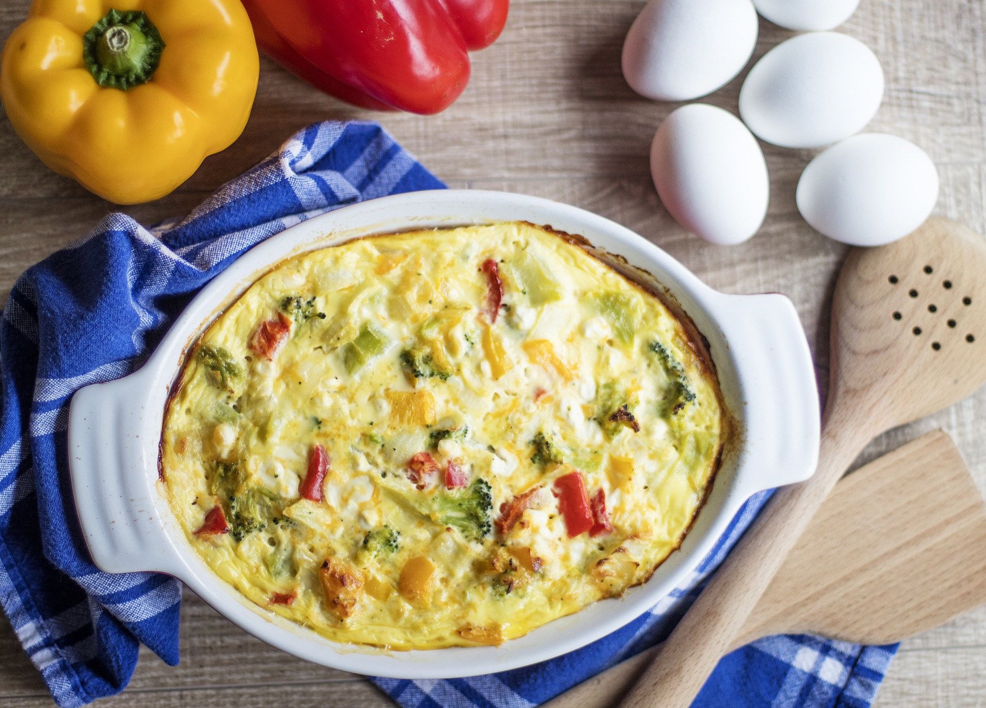
Looking to other people’s writing for ideas is like asking for the recipe for your auntie’s amazing potato salad.
You figure out:
1. What you liked.
2. How they did it.
To help you get started on your own
Notes:
Copyright © 2019 Jeanne Wolz, www.teacheroffduty.com. For classroom use only by a single teacher. Please purchase one licensure per teacher using this product. All rights reserved.

Slide 43
As each poem plays, take notes…
How did the poet end their poem? (what did you like?)
How could you do something similar?
(what’s the recipe?)
Notes:
Copyright © 2019 Jeanne Wolz, www.teacheroffduty.com. For classroom use only by a single teacher. Please purchase one licensure per teacher using this product. All rights reserved.

Slide 44
Talk with your partner
What did the author do?
The author _____
I liked how they ______
What could you do?
In my own poem, I could _____
For mine, I might say ______
Notes:
Copyright © 2019 Jeanne Wolz, www.teacheroffduty.com. For classroom use only by a single teacher. Please purchase one licensure per teacher using this product. All rights reserved.

Slide 45
Talk with your partner
Which poem will you write today?
How can you start your poem?
If your partner’s struggling, help them out!
“What about…”
“What was your favorite parts of the examples?
Notes:
Copyright © 2019 Jeanne Wolz, www.teacheroffduty.com. For classroom use only by a single teacher. Please purchase one licensure per teacher using this product. All rights reserved.

Slide 46
Work-Time Today:
Begin drafting your poem
Don’t worry about it being perfect—we can revise it later. Just write!
Notes:
Copyright © 2019 Jeanne Wolz, www.teacheroffduty.com. For classroom use only by a single teacher. Please purchase one licensure per teacher using this product. All rights reserved.

Slide 47
Share-Time Today:
Let’s hear a couple of your beginnings!
Those listening: pay attention to what they did well!
Notes:
Copyright © 2019 Jeanne Wolz, www.teacheroffduty.com. For classroom use only by a single teacher. Please purchase one licensure per teacher using this product. All rights reserved.

Slide 48
Homework Reminder
Don’t forget to send me awesome slam poems or songs that have to do with identity or assumptions!
Notes:
Copyright © 2019 Jeanne Wolz, www.teacheroffduty.com. For classroom use only by a single teacher. Please purchase one licensure per teacher using this product. All rights reserved.

Slide 49
Day 6
Notes:
Copyright © 2019 Jeanne Wolz, www.teacheroffduty.com. For classroom use only by a single teacher. Please purchase one licensure per teacher using this product. All rights reserved.

Slide 50
Do Now
Write in planner: Finish half of poem, include a new poetic device | 2. Get out: Journal Poem you started yesterday
Learning Intentions
What: Identify several different types of poetic devices and include them in our writing. How: By reading a new poem and talking and writing about what we like. Why: Because poetic devices are what help make poems stick with people.
Notes:
Copyright © 2019 Jeanne Wolz, www.teacheroffduty.com. For classroom use only by a single teacher. Please purchase one licensure per teacher using this product. All rights reserved.

Slide 51
“The Madness Vase”
Please open your journal to a blank page.
Notes:
Copyright © 2019 Jeanne Wolz, www.teacheroffduty.com. For classroom use only by a single teacher. Please purchase one licensure per teacher using this product. All rights reserved.

Slide 52
As the poet is performing, write down…
Lines, words, or phrases that stick out to you.
Notes:
Copyright © 2019 Jeanne Wolz, www.teacheroffduty.com. For classroom use only by a single teacher. Please purchase one licensure per teacher using this product. All rights reserved.

Slide 53
Take a couple moments to write in your journal:
What are your thoughts after the poem?
No one will read this but you.
Notes:
Copyright © 2019 Jeanne Wolz, www.teacheroffduty.com. For classroom use only by a single teacher. Please purchase one licensure per teacher using this product. All rights reserved.

Slide 54
Awesome Phrases and Poetic Devices in “The Madness Vase”
What parts or phrases from the poem stood out to you, and why?
Notes:
Copyright © 2019 Jeanne Wolz, www.teacheroffduty.com. For classroom use only by a single teacher. Please purchase one licensure per teacher using this product. All rights reserved.

Slide 55
Which poetic device(s) would you like to add to your writing today?
Notes:
Copyright © 2019 Jeanne Wolz, www.teacheroffduty.com. For classroom use only by a single teacher. Please purchase one licensure per teacher using this product. All rights reserved.

Slide 56
Work-Time Today:
Continue working on your poems from yesterday
If you feel “finished,” here are some ways to keep improving your poem:
Add more poetic devices
Add more to your poem (can you think of a story relating to your poem? Can you explain a part of your poem in more detail?)
Hide your poem from yourself and re-write it
Notes:
Copyright © 2019 Jeanne Wolz, www.teacheroffduty.com. For classroom use only by a single teacher. Please purchase one licensure per teacher using this product. All rights reserved.

Slide 57
Share-Time Today:
Share with your neighbour ONE poetic device you included:
“I did [poetic device] here. I wrote…”
Notes:
Copyright © 2019 Jeanne Wolz, www.teacheroffduty.com. For classroom use only by a single teacher. Please purchase one licensure per teacher using this product. All rights reserved.

Slide 58
Homework Reminder
Don’t forget to send me awesome slam poems or songs that have to do with identity or assumptions!
Notes:
Copyright © 2019 Jeanne Wolz, www.teacheroffduty.com. For classroom use only by a single teacher. Please purchase one licensure per teacher using this product. All rights reserved.

Slide 59
Day 7
Notes:
Copyright © 2019 Jeanne Wolz, www.teacheroffduty.com. For classroom use only by a single teacher. Please purchase one licensure per teacher using this product. All rights reserved.

Slide 60
Do Now
Write in planner: Finish half of 1st draft of 1st poem | 2. Get out: “Awesome Devices and Phrases” log Small piece of paper—tear and share!
Learning Intentions
What: We will write to a specific audience and add poetic devices to make our message stronger. How: By discussing who to perform to and adding poetic devices in our writing. Why: Because it’s important to know who we’re writing to in order to write in a way that’s convincing to THEM.
Notes:
Copyright © 2019 Jeanne Wolz, www.teacheroffduty.com. For classroom use only by a single teacher. Please purchase one licensure per teacher using this product. All rights reserved.

Slide 61
Which poetic device will you focus on today?
Notes:
Copyright © 2019 Jeanne Wolz, www.teacheroffduty.com. For classroom use only by a single teacher. Please purchase one licensure per teacher using this product. All rights reserved.

Slide 62
Work-Time Today:
Continue working on your poems from yesterday
If you feel “finished,” here are some ways to keep improving your poem:
Revision Ideas
Add more poetic devices Think of a story relating to your poem. Add it to to your poem as an example Put your poem aside and re-write it (don’t look!) After trying all of these, you may work on your new poem
Notes:
Copyright © 2019 Jeanne Wolz, www.teacheroffduty.com. For classroom use only by a single teacher. Please purchase one licensure per teacher using this product. All rights reserved.

Slide 63
Share-Time Today:
Underline your favorite line you wrote over the past 3 days, and share with your partner
Notes:
Copyright © 2019 Jeanne Wolz, www.teacheroffduty.com. For classroom use only by a single teacher. Please purchase one licensure per teacher using this product. All rights reserved.

Slide 64
Day 8
Notes:
Copyright © 2019 Jeanne Wolz, www.teacheroffduty.com. For classroom use only by a single teacher. Please purchase one licensure per teacher using this product. All rights reserved.

Slide 65
Do Now
Write in planner: Finish 1st draft of your 1st poem | 2. Get out: Poem you wrote yesterday
Learning Intentions
What: We will write effective endings to our poem. How: By re-reading and discussing what made good endings with other poems we’ve read. Why: Because your ending is what your audience will remember and your call to ACTION!
Notes:
Copyright © 2019 Jeanne Wolz, www.teacheroffduty.com. For classroom use only by a single teacher. Please purchase one licensure per teacher using this product. All rights reserved.

Slide 66
Quick-write
What makes an awesome ending to a poem, song, story, or other piece of writing?
Notes:
Copyright © 2019 Jeanne Wolz, www.teacheroffduty.com. For classroom use only by a single teacher. Please purchase one licensure per teacher using this product. All rights reserved.

Slide 67
How’d they do that? Let’s re-watch some poems…
Notes:
Copyright © 2019 Jeanne Wolz, www.teacheroffduty.com. For classroom use only by a single teacher. Please purchase one licensure per teacher using this product. All rights reserved.

Slide 68
Looking to other people’s writing for ideas is like asking for the recipe for your auntie’s amazing potato salad.
You figure out:
1. What you liked.
2. How they did it.
To help you get started on your own
Notes:
Copyright © 2019 Jeanne Wolz, www.teacheroffduty.com. For classroom use only by a single teacher. Please purchase one licensure per teacher using this product. All rights reserved.

Slide 69
As each poem plays, take notes…
How did the poet end their poem? (what did you like?)
How could you do something similar?
(what’s the recipe?)
Notes:
Copyright © 2019 Jeanne Wolz, www.teacheroffduty.com. For classroom use only by a single teacher. Please purchase one licensure per teacher using this product. All rights reserved.

Slide 70
Talk with your partner
What did the author do?
The author _____
I liked how they ______
What could you do?
In my own poem, I could _____
For mine, I might say ______
Notes:
Copyright © 2019 Jeanne Wolz, www.teacheroffduty.com. For classroom use only by a single teacher. Please purchase one licensure per teacher using this product. All rights reserved.

Slide 71
Talk with your partner
How can you end your poem?
If your partner’s struggling, help them out!
“What about…”
“What was your favorite parts of the examples?
Notes:
Copyright © 2019 Jeanne Wolz, www.teacheroffduty.com. For classroom use only by a single teacher. Please purchase one licensure per teacher using this product. All rights reserved.

Slide 72
Work-Time Today:
Finish your first draft of your first poem—if you don’t finish today, finish for homework
If you finish early, feel free to start your second poem!
Don’t worry about it being perfect—we can revise it later. Just write!
Notes:
Copyright © 2019 Jeanne Wolz, www.teacheroffduty.com. For classroom use only by a single teacher. Please purchase one licensure per teacher using this product. All rights reserved.

Slide 73
Share-Time Today:
Let’s hear a couple of your endings!
“For my ending, I tried to …”
“I wrote…”
Those listening: pay attention to what they did well
Notes:
Copyright © 2019 Jeanne Wolz, www.teacheroffduty.com. For classroom use only by a single teacher. Please purchase one licensure per teacher using this product. All rights reserved.

Slide 74
Day 9
Notes:
Copyright © 2019 Jeanne Wolz, www.teacheroffduty.com. For classroom use only by a single teacher. Please purchase one licensure per teacher using this product. All rights reserved.

Slide 75
Work-Time Today:
Start your first draft of your SECOND poem
If you feel “finished,” here are some ways to keep improving your poem:
Revision Ideas
Add more poetic devices Think of a story relating to your poem. Add it to to your poem as an example Put your poem aside and re-write it (don’t look!) After trying all of these, you may work on your new poem
Notes:
Copyright © 2019 Jeanne Wolz, www.teacheroffduty.com. For classroom use only by a single teacher. Please purchase one licensure per teacher using this product. All rights reserved.

Slide 76
Share-Time Today:
Share with a partner:
Was it easier or harder to start your second poem than it was your first? Why?
\l
Notes:
Copyright © 2019 Jeanne Wolz, www.teacheroffduty.com. For classroom use only by a single teacher. Please purchase one licensure per teacher using this product. All rights reserved.

Slide 77
Day 10
Notes:
Copyright © 2019 Jeanne Wolz, www.teacheroffduty.com. For classroom use only by a single teacher. Please purchase one licensure per teacher using this product. All rights reserved.

Slide 78
Do Now
Write in planner: Finish half of 2nd poem Add new poetic device | 2. Get out: 2nd poem “Awesome Phrases and Poetic Devices Log”
Learning Intentions
What: Identify new types of poetic devices and include them in our writing. How: By reading a new poem and discussing what we like. Why: Because poetic devices are what help make poems stick with people, and we can learn examples from others to help keep improving our own poems.
Notes:
Copyright © 2019 Jeanne Wolz, www.teacheroffduty.com. For classroom use only by a single teacher. Please purchase one licensure per teacher using this product. All rights reserved.

Slide 79
As you listen, write down phrases that stand out to you
Notes:
Copyright © 2019 Jeanne Wolz, www.teacheroffduty.com. For classroom use only by a single teacher. Please purchase one licensure per teacher using this product. All rights reserved.

Slide 80
Discuss!
Sentence stems that help you elaborate:
“I liked the part where it said “_____” because “_____”
I also liked the part you mentioned where it says, “____” because ___”
“It was cool because it ______”
“In my poem, I think I will _____”
Questions to help conversation:
Which part stood out to you the most?
Why did you like that part?
Can you tell me a little more about why you thought that?
How might you do something similar in your poem?
Notes:
Copyright © 2019 Jeanne Wolz, www.teacheroffduty.com. For classroom use only by a single teacher. Please purchase one licensure per teacher using this product. All rights reserved.

Slide 81
Which poetic device(s) would you like to add to your writing today?
Notes:
Copyright © 2019 Jeanne Wolz, www.teacheroffduty.com. For classroom use only by a single teacher. Please purchase one licensure per teacher using this product. All rights reserved.

Slide 82
Work-Time Today:
Work on poems from yesterday; add new poetic device
If you feel “finished,” here are ways to improve your poem:
Revision Ideas
Add a new type of poetic device you haven’t tried Add sensory details (sight, smell, sound, touch, taste) Try adding another assumption to your poem that is related from your list
Notes:
Copyright © 2019 Jeanne Wolz, www.teacheroffduty.com. For classroom use only by a single teacher. Please purchase one licensure per teacher using this product. All rights reserved.

Slide 83
Share-Time Today:
Share with your partner where you added the new poetic device you focused on today
“I focused on [poetic device] today. Here’s one example I wrote…”
Notes:
Copyright © 2019 Jeanne Wolz, www.teacheroffduty.com. For classroom use only by a single teacher. Please purchase one licensure per teacher using this product. All rights reserved.

Slide 84
Day 11
Notes:
Copyright © 2019 Jeanne Wolz, www.teacheroffduty.com. For classroom use only by a single teacher. Please purchase one licensure per teacher using this product. All rights reserved.

Slide 85
Do Now
Write in planner: Finish 1st draft of 2nd poem | 2. Get out: 2nd poem “Awesome Phrases and Poetic Devices Log”
Learning Intentions
What: Teach ourselves a few more poetic devices. How: By listening to a poem of our own choice and discussing with a partner. Why: Because we need to be able to teach ourselves new techniques without the help of a teacher.
Notes:
Copyright © 2019 Jeanne Wolz, www.teacheroffduty.com. For classroom use only by a single teacher. Please purchase one licensure per teacher using this product. All rights reserved.

Slide 86
As you listen, write down phrases that stand out to you
Pick a slam poem with a partner from the available choices
Watch poem, writing down what you notice
Discuss your findings
Notes:
Copyright © 2019 Jeanne Wolz, www.teacheroffduty.com. For classroom use only by a single teacher. Please purchase one licensure per teacher using this product. All rights reserved.

Slide 87
Discuss!
Sentence stems that help you elaborate:
“I liked the part where it said “_____” because “_____”
I also liked the part you mentioned where it says, “____” because ___”
“It was cool because it ______”
“In my poem, I think I will _____”
Questions to help conversation:
Which part stood out to you the most?
Why did you like that part?
Can you tell me a little more about why you thought that?
How might you do something similar in your poem?
Notes:
Copyright © 2019 Jeanne Wolz, www.teacheroffduty.com. For classroom use only by a single teacher. Please purchase one licensure per teacher using this product. All rights reserved.

Slide 88
Work-Time Today:
FINISH draft 1 of poem 2—if you don’t finish during class, finish it for homework
If you feel “finished,” here are some ways to improve your poem:
Revision Ideas
Add a new type of poetic device you haven’t tried Add sensory details (sight, smell, sound, touch, taste) Try adding another assumption to your poem that is related from your list
Notes:
Copyright © 2019 Jeanne Wolz, www.teacheroffduty.com. For classroom use only by a single teacher. Please purchase one licensure per teacher using this product. All rights reserved.

Slide 89
Share-Time Today:
Find your two favorite examples from your own writing of poetic devices
Write them on the appropriate poster
Read others—give ☺ or or short, positive reaction
“I focused on [poetic device] today. Here’s one example I wrote…”
Notes:
Copyright © 2019 Jeanne Wolz, www.teacheroffduty.com. For classroom use only by a single teacher. Please purchase one licensure per teacher using this product. All rights reserved.

Slide 90
Day 12
Notes:
Copyright © 2019 Jeanne Wolz, www.teacheroffduty.com. For classroom use only by a single teacher. Please purchase one licensure per teacher using this product. All rights reserved.

Slide 91
Do Now
Write in planner: Finish revising 50% of poem | 2. Get out: Favorite poem you’ve written
Learning Intentions
What: Try different ways to revise our poems. How: Re-reading and re-writing parts or all of our poem. Why: Because revisions help us expand the possibilities for our poems.
Notes:
Copyright © 2019 Jeanne Wolz, www.teacheroffduty.com. For classroom use only by a single teacher. Please purchase one licensure per teacher using this product. All rights reserved.

Slide 92
Work-Time Today:
FINISH revising 50% of poem
If you can’t think of new ways to revise, see ideas below
Revision Ideas
Don’t look at your poem. On a new piece of paper, write it again in a new way Look at the lists of poetic devices, pick a new one, and re-word different parts of your poem to include it Randomly rearrange chunks of your poem. Look for new ideas on how to order what you wrote. Add details to your favorite part of the poem. Take out your least favorite part.
Notes:
Copyright © 2019 Jeanne Wolz, www.teacheroffduty.com. For classroom use only by a single teacher. Please purchase one licensure per teacher using this product. All rights reserved.

Slide 93
Share-Time Today:
Underline everything that you changed today
Explain to a partner what and why you revised what you did today:
I changed ____ because ____
I took out _____ because ____
I added ____ because ______
Notes:
Copyright © 2019 Jeanne Wolz, www.teacheroffduty.com. For classroom use only by a single teacher. Please purchase one licensure per teacher using this product. All rights reserved.

Slide 94
Day 13
Notes:
Copyright © 2019 Jeanne Wolz, www.teacheroffduty.com. For classroom use only by a single teacher. Please purchase one licensure per teacher using this product. All rights reserved.

Slide 95
Do Now
Write in planner: Finish revisions | 2. Get out: Poem you picked yesterday
Learning Intentions
What: Provide positive and constructive feedback, and revise our poems based on feedback. How: Read a peer’s poem, then write and speak positive and constructive feedback for them. Why: Because giving and receiving feedback is a critical way that writers improve their writing.
Notes:
Copyright © 2019 Jeanne Wolz, www.teacheroffduty.com. For classroom use only by a single teacher. Please purchase one licensure per teacher using this product. All rights reserved.

Slide 96
Feedback Protocol
Swap poems
Ask partner what their goals are
Read about 5 lines
Tell partner feedback—partner writes it down
One positive
One suggestion
Continue and repeat
Notes:
Copyright © 2019 Jeanne Wolz, www.teacheroffduty.com. For classroom use only by a single teacher. Please purchase one licensure per teacher using this product. All rights reserved.

Slide 97
Work-Time Today:
Provide feedback
Revise poems based on feedback
Notes:
Copyright © 2019 Jeanne Wolz, www.teacheroffduty.com. For classroom use only by a single teacher. Please purchase one licensure per teacher using this product. All rights reserved.

Slide 98
Share-Time Today:
Independent Reflection:
What was the most helpful feedback from today?
Why was it helpful?
Notes:
Copyright © 2019 Jeanne Wolz, www.teacheroffduty.com. For classroom use only by a single teacher. Please purchase one licensure per teacher using this product. All rights reserved.

Slide 99
Day 14
Notes:
Copyright © 2019 Jeanne Wolz, www.teacheroffduty.com. For classroom use only by a single teacher. Please purchase one licensure per teacher using this product. All rights reserved.

Slide 100
Do Now
Write in planner: Finish performance plans | 2. Get out: Poem you picked
Learning Intentions
What: Identify and plan performance techniques for our poems. How: Speak and write about what we notice other poets do, and then mark our own poems for plans. Why: About 93% of communication is through our body language and tone—so it’s important to plan this!
Notes:
Copyright © 2019 Jeanne Wolz, www.teacheroffduty.com. For classroom use only by a single teacher. Please purchase one licensure per teacher using this product. All rights reserved.

Slide 101
Which poem that we’ve seen had the most powerful performance?
What did you notice they did that was effective?
Write what you notice in your “How to Perform a Poem for Maximum Effect” log.
Notes:
Copyright © 2019 Jeanne Wolz, www.teacheroffduty.com. For classroom use only by a single teacher. Please purchase one licensure per teacher using this product. All rights reserved.

Slide 102
Work-Time Today:
Mark your poem for performance plans. Some ideas for markings:
Slow
Fast
Pause
Angry
Sarcastic
Point
Hand chop
Finger count
Shake head
Nod
Notes:
Copyright © 2019 Jeanne Wolz, www.teacheroffduty.com. For classroom use only by a single teacher. Please purchase one licensure per teacher using this product. All rights reserved.

Slide 103
Share-Time Today:
What did you plan for your performance?
Tomorrow, we will practice performing!
☺
Notes:
Copyright © 2019 Jeanne Wolz, www.teacheroffduty.com. For classroom use only by a single teacher. Please purchase one licensure per teacher using this product. All rights reserved.

Slide 104
Day 15
PERFORMANCE DAY!!!
Notes:
Copyright © 2019 Jeanne Wolz, www.teacheroffduty.com. For classroom use only by a single teacher. Please purchase one licensure per teacher using this product. All rights reserved.

Slide 105
Do Now
Write in planner: Practice performance! | 2. Get out: Poem you picked + performance notes
Learning Intentions
What: Perform poems using tone, volume, and gestures to help meaning. How: Perform poem out loud to several people, writing and reading feedback to each other. Why: The only way to get better and feel better is to do it over and over and over and over…
Notes:
Copyright © 2019 Jeanne Wolz, www.teacheroffduty.com. For classroom use only by a single teacher. Please purchase one licensure per teacher using this product. All rights reserved.

Slide 106
Share-time
Well done!! Performing is scary, so you should be proud of whatever steps you took towards performing today
Complete numbers 2-4 on your “Slam Poem Performance Practice Reflection” sheet
Notes:
Copyright © 2019 Jeanne Wolz, www.teacheroffduty.com. For classroom use only by a single teacher. Please purchase one licensure per teacher using this product. All rights reserved.

